Slide 1
A leading solar and storage energy company that develops, owns and operates projects across the United States
1

Slide 2
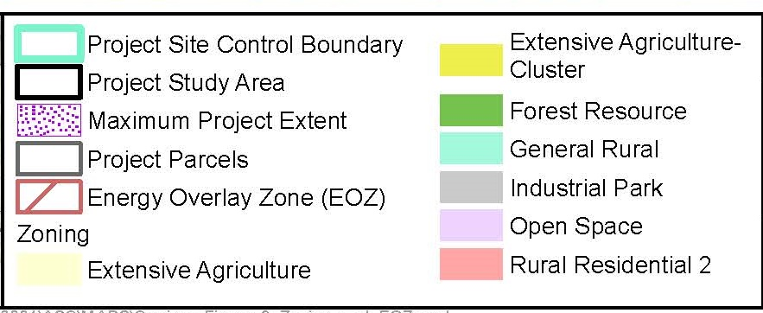
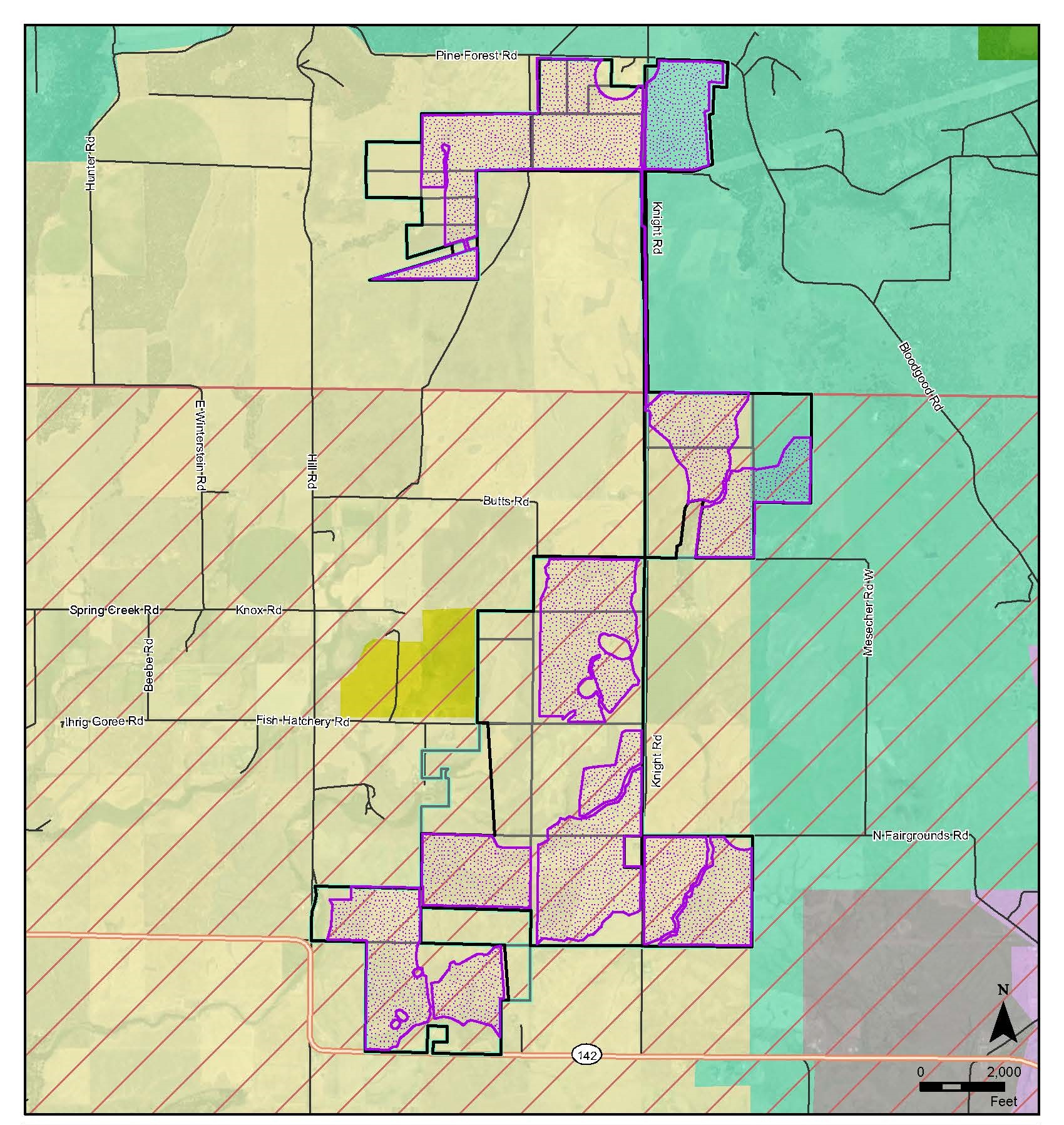
Zoning and EOZ

Slide 3
Klickitat County Goals and Policies
Guidelines Compliance
Environment
Natural Resources
Economy
Maximum Project Extent (MPE) designed to avoid sensitive areas including wetlands and waters
Layout designed to be compliant with county and state noise regulations
Best practices to avoid impacts during construction and operations
Visual resources preserved
County policies support state-wide goals for renewable energy development
Project compatible with adjacent agricultural areas
Preserves family farm ownership
Land remains suitable for future agricultural production following Project decommissioning
No irretrievable loss of agricultural land
Project will provide 300+ jobs during construction
Operations and maintenance jobs during Project life
Significant addition to County tax base
Housing and Residential
Transportation
Public Services
Minimum 500’ setbacks from nonparticipating homes
Minimal impacts to level of service on area roads
Utilities Element goals encourage energy production in Klickitat County
Project relies on existing utility corridors as encouraged by goals
Public safety plans coordinated with local agencies
Recreational opportunities preserved

Slide 4
Mitigation Measures and Updated Conditions
Additional Wetland Accommodations
Increased Project Setbacks
Revised Perimeter Fence Design
Setbacks along Knight Road have been increased to a minimum of 100 feet to the fence line and 120 feet to solar panels
Similar setbacks have been provided where project is adjacent to DNR property boundaries
The chain link fence with barbed wire has been replaced with a game fence
Project layout within the Maximum Project Extent has been adjusted to avoid additional wetland items discovered by Ecology in follow up site visit in 2024
Dept. of Agriculture Recommendations
MDNS Mitigation Measures
Noise Monitoring
Coordination with WSDA has produced an agreed upon soil testing regimen
Carriger Solar to perform noise monitoring in compliance with recommendations of EFSEC in MDNS mitigation measures
Additional mitigation measures have been identified in EFSEC’s MDNS. These mitigation measures address items related to air, water, plants, wildlife, site restoration, noise/vibration, historic and cultural resources, transportation, and public services. Those can be found at: https://www.efsec.wa.gov/sites/default/files/230001/002/20250404_Final_Carriger_MDNS.pdf

Slide 5
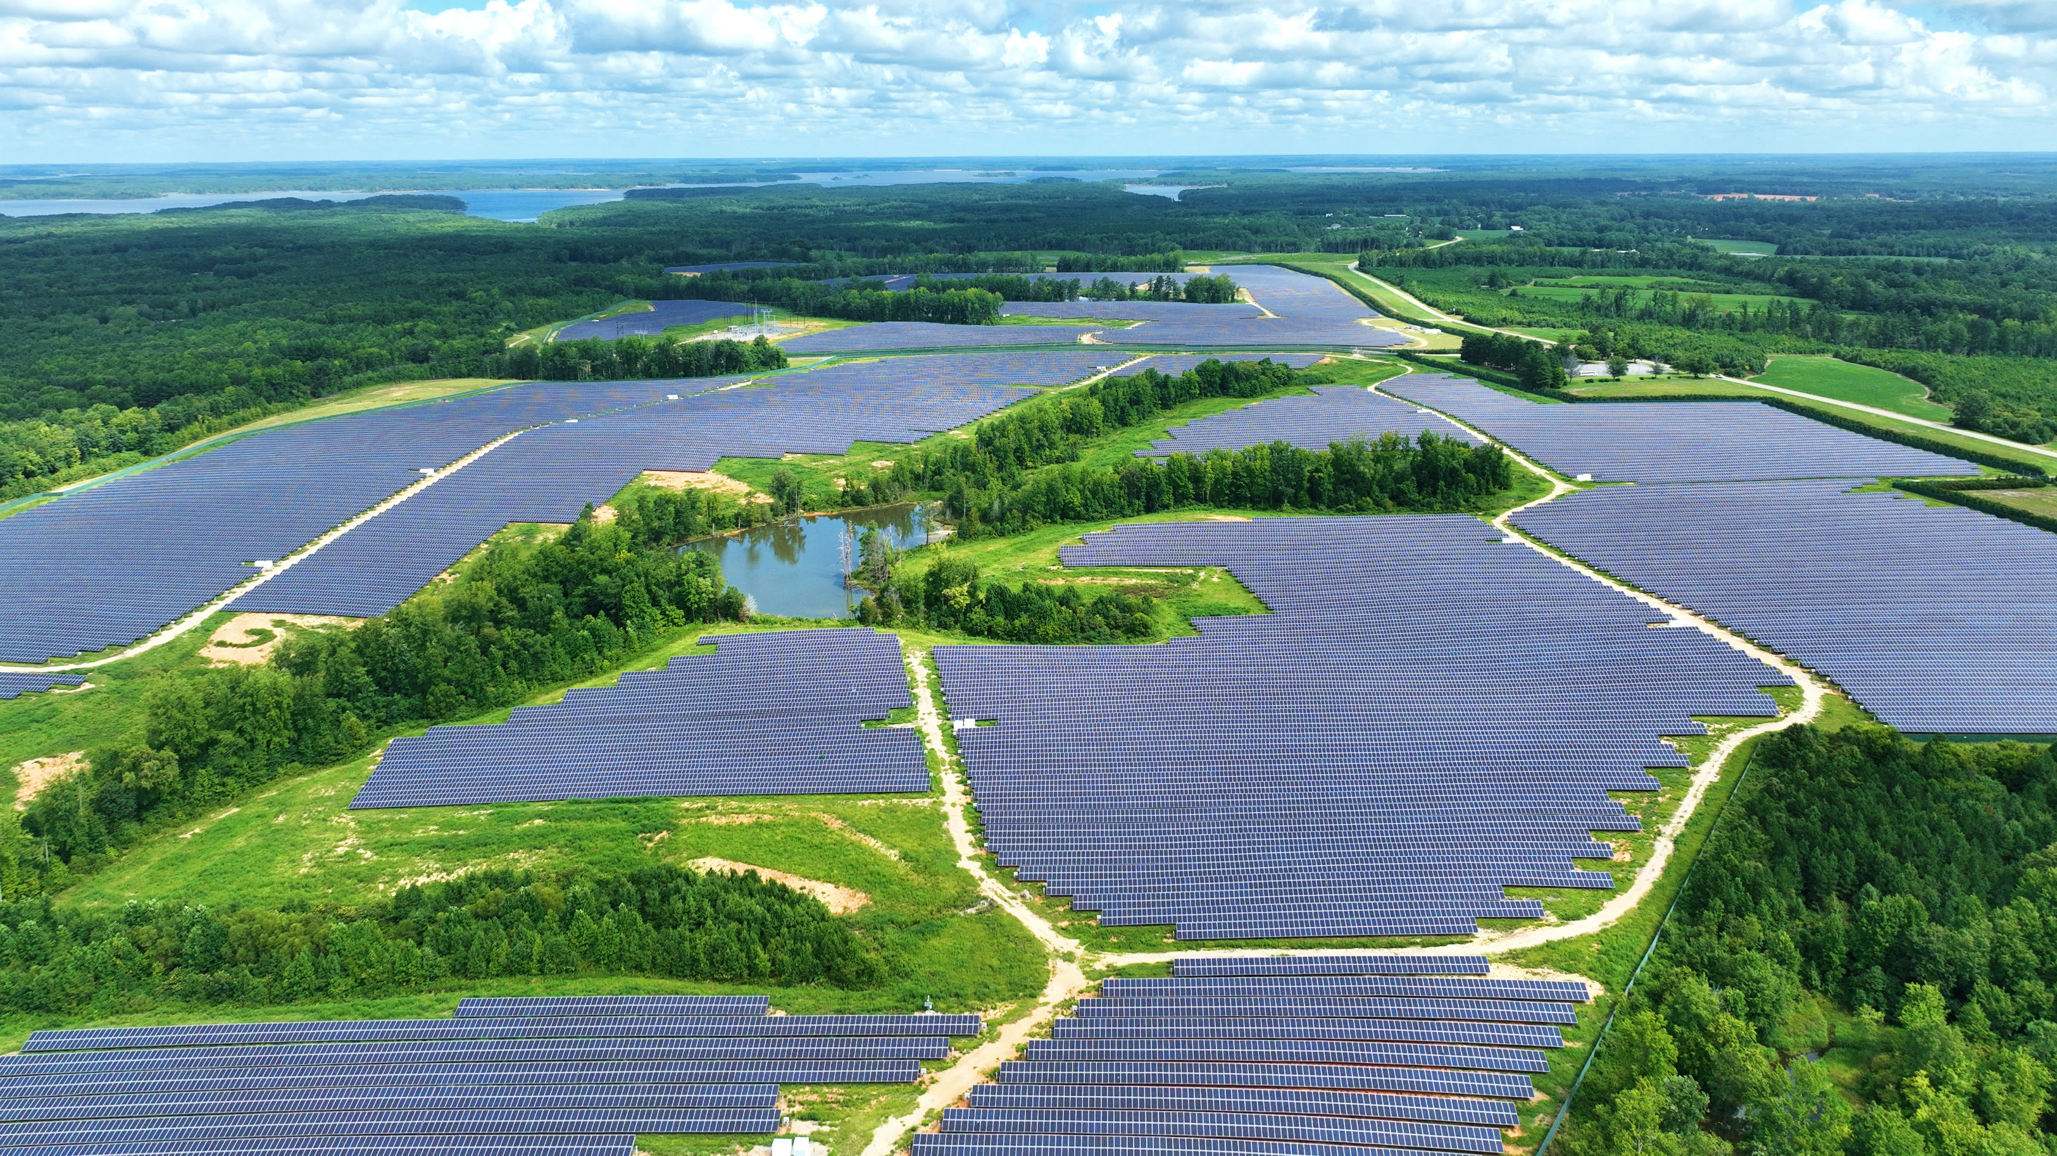
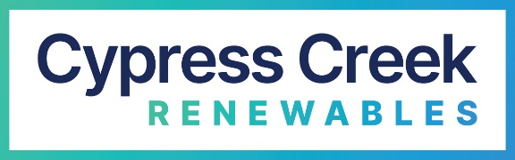
THANK YOU!

